Slide 1
Sequential Circuits I
Flip Flops
CSE 4205: Digital Logic Design
Aashnan Rahman
Junior Lecturer
Department of Computer Science and Engineering (CSE)
Islamic University of Technology

Slide 2
01
Sequential Circuits
Combinational Circuits with Memory Elements

Slide 3
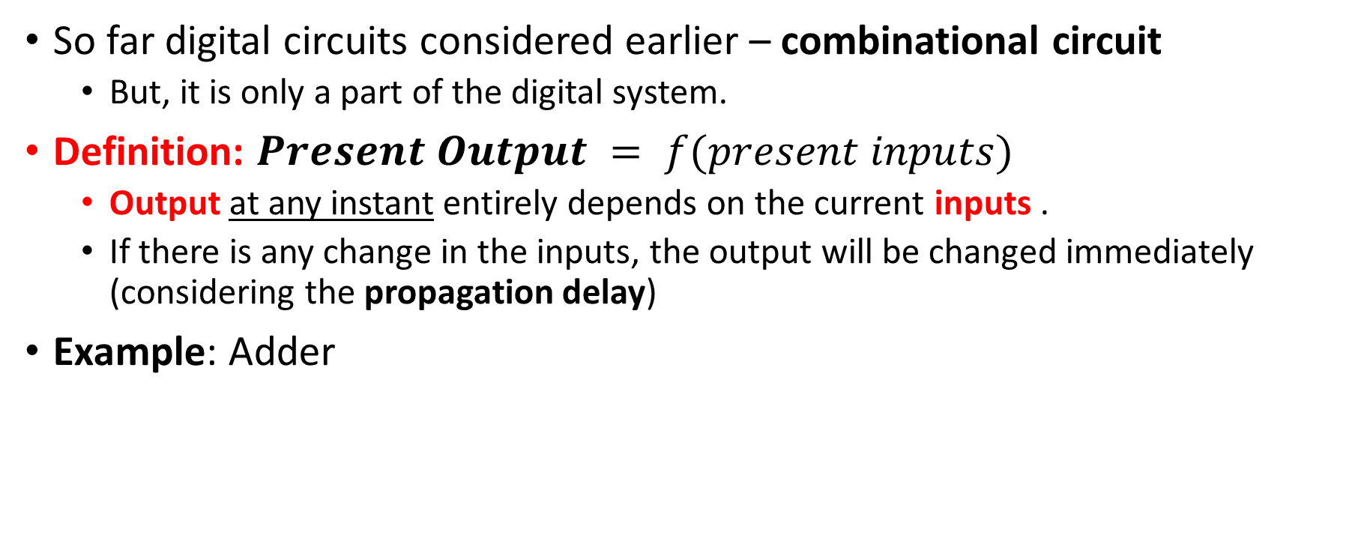
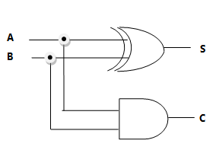
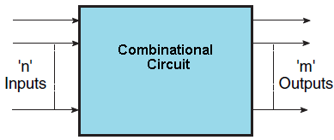
Combinational Circuits

Slide 4
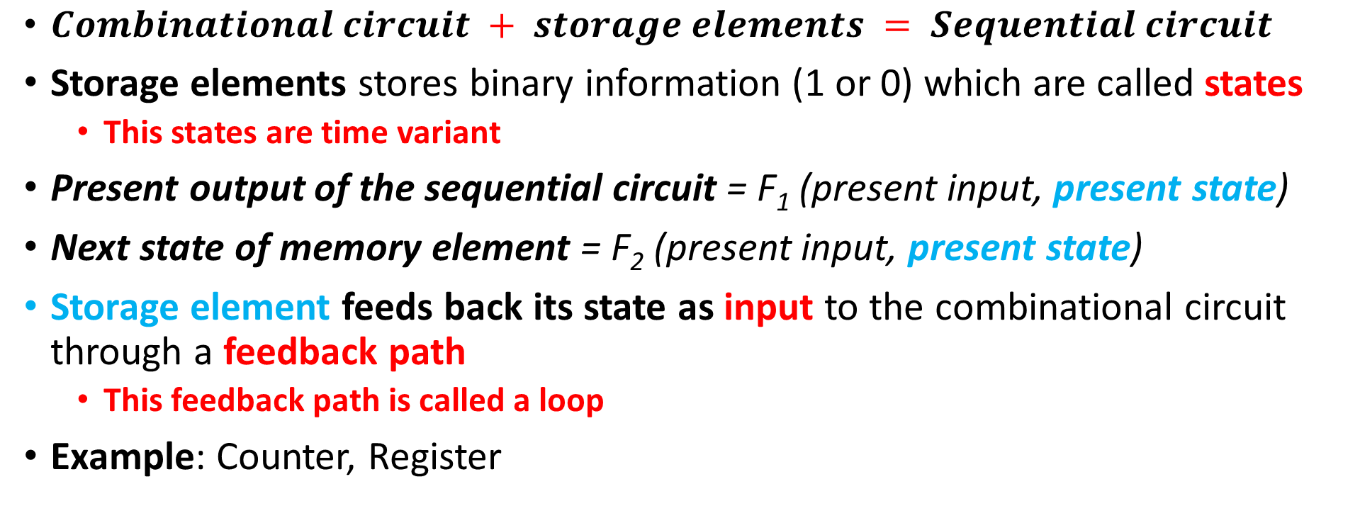
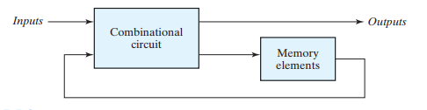
Sequential Circuits

Slide 5
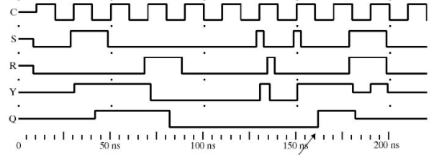
Time Sequence
Sequential circuit includes time sequence of inputs, outputs and internal memory states
  This time-sequence determines the behavior of a sequential circuit.

Slide 6
02
Classification of Sequential Circuits
Synchronous or Asynchronous

Slide 7
Classification of Sequential Circuits
Two types of sequential circuit – based on timing of their input signal
  Synchronous or clocked sequential circuit
  Asynchronous or unclocked sequential circuit

Slide 8
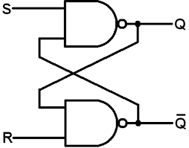
Asynchronous Sequential Circuits
  Behavior defined based on the order/sequence of input signals at any instant of time
    Only affected whenever the inputs change
    No synchronization with clock pulse
  Example: Latch
  Time delayed memory element
    Propagation delay is kept higher to provide storage attributes
    Intentionally built with delay units
  Drawback: unstable states at times due to some undesirable feedbacks
  Advantage: faster than the synchronous sequential circuit

Slide 9
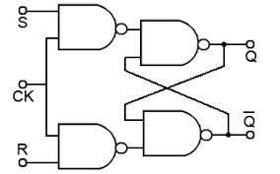
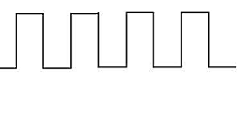
Synchronous Sequential Circuits
  Behavior defined based on the input signals at discrete instants of time
  Example: Flip-flop
  Synchronization achieved through timing device
    Also, known as system clock or master clock generator
    It generates a periodic train of clock pulses
    This clock pulse is ANDed with specific input signal
  Clock pulse driven storage element
    Only affected with arrival of each clock pulse
  Clock pulse will define when changes will occur
  External inputs will define what changes will occur
  Advantages – eliminate instability problem
  Common practice in electronic devices

Slide 10
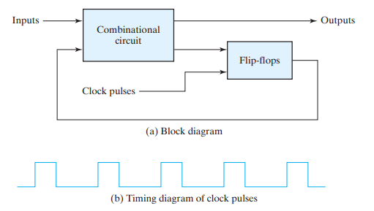
Clocked Sequential Circuits
Note: Here, the storage element is a flip-flop

Slide 11
03
Flip Flops

Slide 12
Flip Flops
Memory elements in clocked sequential circuit
A binary/digital memory cell that stores one bit of information
Number of inputs – One or more
Two outputs – normal (Q) and complement (Q’) value of the bit stored
  Q=1, Q’=0 : set (1) state and Q=0, Q’=1 : reset (0) state
  Q and Q’ can’t be same state at a time
  If it happens, it goes to undefined state

Slide 13
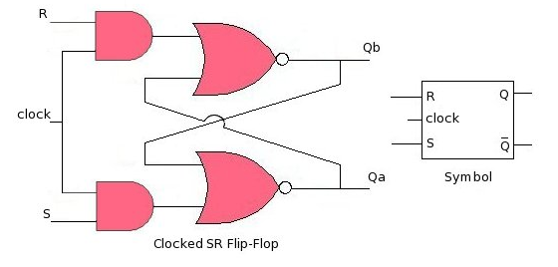
Flip Flops
Implemented with NAND or NOR gates
Differences in types of flip-flops:
  Based on number of inputs and the manner in which the inputs affect the binary state
Edge triggered device

Slide 14
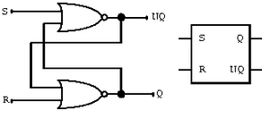
Latch
It has two stable states
Used to store binary information
  Binary memory element
Latches are basic storage elements that operate with signal levels (rather than signal transitions).
  Level triggered device
It is not synchronized with clock pulses

Slide 15
Latch vs Flip Flops
The state of flip-flop changes at active state of clock pulses and remains unaffected when the clock pulse is not active.
  It serves as a memory element in synchronous sequential circuits
  It is applied with clock pulses
In particular, the unclocked flip-flops (i.e., latches) changes its states of the output immediately based on the applied input
  It serves as memory elements in asynchronous sequential circuits.
  Sometimes it is applied enable input

Slide 16
04
Types of Flip Flops
S-R, D, J-K, T

Slide 17
Types of Flip Flops
Based on how the inputs and clock pulses cause transition between two states:
  S-R (Set-Reset) flip-flop
  D (Data) flip-flop
  J-K (J: set, K: reset) flip-flop
  T (Toggle) flip-flop

Slide 18
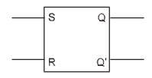
Type I : SR Flip Flop
Two inputs – Set (S) and Reset (R)
Two outputs – Q and Q’ (complement to each other)
Made of cross-coupled connection from output to input constituting a feedback path

Slide 19
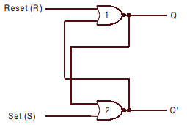
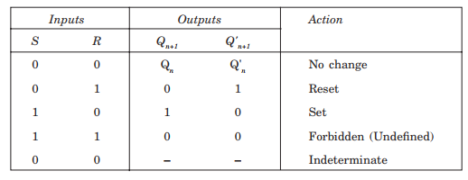
Type I : SR Latch with NOT Gates (level edge Triggered)
Not clocked or synchronized
  Level triggered
  Asynchronous sequential circuit
(Memory state)
(Reset state)
(Set state)
(after an undefined occurrence)
Note: The output of a NOR gate is zero (0) if any of the inputs are 1, irrespective of the other input.

Slide 20
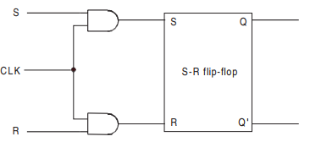
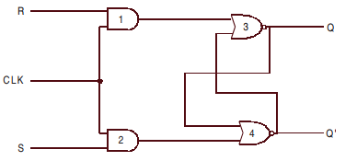
Type I : Clocked SR Flip Flop
Synchronous circuit
  Activated during a clock pulse is present
From a latch, a flip-flop can be produced including an additional input to control the behavior of the circuit
latch

Slide 21
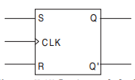
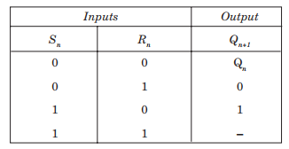
Type I : SR Flip Flop
Logic symbol and truth table
Three inputs – S, R and CLK
  The clock input is marked with a triangle denoting edge triggered flip-flop
Q_{n} denotes output at n^{th} time and Q_{n+1} denotes output at (n+1)^{th} time

Slide 22
Characteristic and Truth Table
Characteristic table and truth table:
  Truth table with present input(s) and present state(s) as input column and next state(s) as output column refers to a characteristic table
  It refers to the operational characteristics of the flip-flop

Slide 23
Preset and Clear Inputs
Initially, a circuit is uncertain with Q and Q’ states
They should be assigned with either set or reset state with direct or asynchronous inputs
  Also, called as overriding inputs
  These inputs are individually named as preset (Pr) and clear (Cr)
These inputs are not synchronized with clock
  They can be applied at any time
  CLK = 0 or 1, doesn’t care at all [but, preferred to be applied when clock is inactive]
Pr=0 and Cr=0 must not be applied, as it leads to an uncertain state
Pr and Cr inputs are used with bubbles considering them active low

Slide 24
Type 2 : D Flip Flop
Single input – Data/Delay (D)
Two outputs – Q and Q’ (complement to each other)
Similar to S and R but R is complement of S to avoid the invalid condition.

Slide 25
Type 3 : JK Flip Flop
Very similar to an S-R flip-flop
  J and K behave like inputs S and R to set and reset the flip-flop
Only difference is eliminating the undefined condition of an S-R flip-flop
  When J=K=1, the flip-flop is said to be in a toggle state
  Toggling means complementing the state in each clock pulse

Slide 26
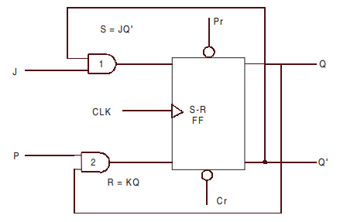
Type 3 : JK Flip Flop
Implementation from S-R flip flop
  Another level of feedback path is included
  Inputs J and K of J-K flip-flop are ANDed with Q’ and Q respectively to obtain the inputs, S and R for S-R flip-flop

Slide 27
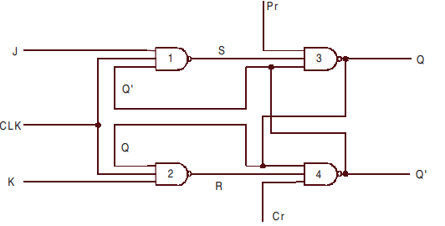
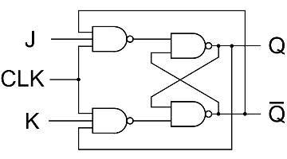
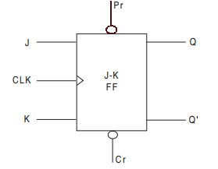
Type 3 : JK Flip Flop
Circuit diagram and block diagram of a J-K flip flop with NAND gates
Same circuit diagram in different orientation

Slide 28
05
Race Around Condition

Slide 29
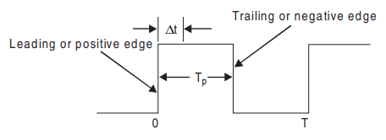
Race Around Condition
Assumption for basic J-K flip-flop:
  The inputs will not be changed any more during a clock pulse
  But, it is not true because of the feedback connections
Consider the scenario: J=K=1
    If Q=1, after △t time, it will be Q=0
    Next, if Q=0, after another △t time, it will be Q=1
  So, basically, during t_{p} time, the output Q will oscillate between 0 and 1
  And, after t_{p} time, the output Q is not certain.
  This situation is called “Race-Around Condition”
△t = propagation delay
t_{p} = pulse duration

Slide 30
Race Around Condition - Solutions
If △t is in nanoseconds and t_{p} in microseconds, output will be changed thousands of times within a clock pulse
  If t_{p} < △t < T, this race around condition could be avoided
  But, this small propagation delay is very difficult to achieve due to hardware limitation
Master-Slave (M-S) flip-flop
Edge triggered flip-flop

Slide 31
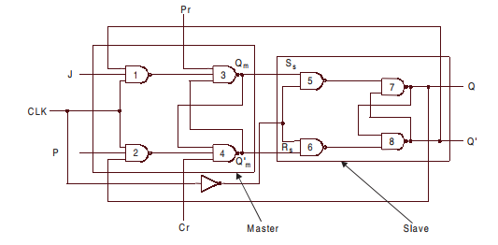
Master Slave JK Flip Flop
A system of two flip-flops – master and slave flip-flops
A clock pulse is applied to master and the inverted form of the same clock is applied to the slave
How to solve RAC problem?
  When CLK=1, gates 5 and 6 will not respond. Output Q and Q’ will only change when CLK=0.

Slide 32
Master Slave JK Flip Flop
  When CLK=1, the master is enabled. Q_{m} output will respond the inputs J and K
    Slave is disabled
  When CLK=0, the slave is enabled. Q output will respond the outputs Q_{m} and Q’_{m}
    Master is disabled

Slide 33
Master Slave Flip Flop
The system of M-S flip-flop is not restricted to J-K M-S flip-flop only
  Also, S-R and D M-S flip-flops are possible
  In all of these cases, the slave is an S-R flip-flop whereas the master changes to J-K, S-R or D flip-flops

Slide 34
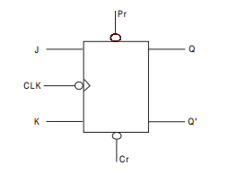
Race Around Condition – Edge Triggered Flip-Flop
The circuit has only single chance to accept inputs (e.g., J and K)
  During:
    Negative transition of the clock pulse – negative edge triggered J-K flip-flop
      Outputs are same M-S flip-flop
    Positive transition of the clock pulse – positive edge triggered J-K flip-flop

Slide 35
T Flip Flop
A slight modification of the J-K flip-flop
  J and K inputs are tied together – have same input
  Referred as T flip-flop
    It has the ability to toggle
One input (T) and two outputs Q and Q’
Two states – toggle (T=1) and memory (T=0) states
Usage: Counter, switching circuits

Slide 36
Excitation Table
A tabulation to figure out all possible input conditions to obtain the desired output condition
  It is required to design a sequential circuit when present state and next state of the flip-flop is specified
    Based on that we need to find out all possible input conditions
    Present and next states are meant the conditions before and after applying the clock pulse respectively

Slide 37
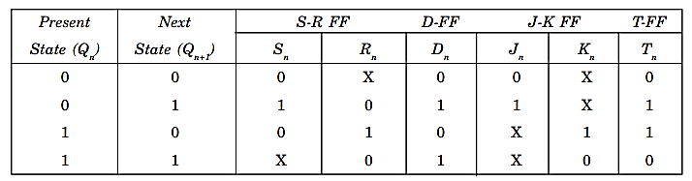
Excitation Table Summary

Slide 38
06
Interconversion of Flip Flops

Slide 39
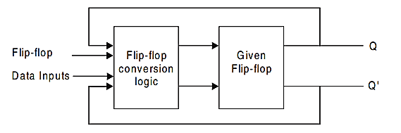
Interconversion of Flip Flops
A conversion logic is required to be designed for such conversions of flip-flops
Steps:
  Produce the characteristic table of the required Flip-flop
  Produce the excitation table of the given Flip-flop
  Combine those tables make a final table including data input(s) of desired flip-flop and Q as the inputs and the input(s) of the given flip-flop as the outputs
Desired

Slide 40
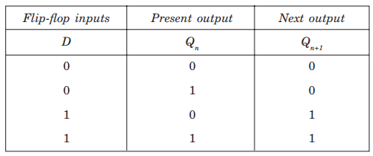
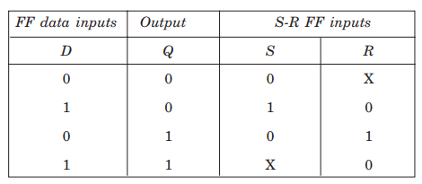
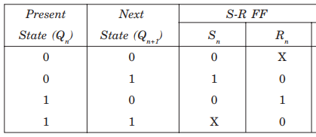
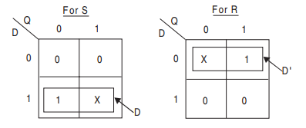
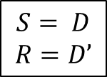
Interconversion of Flip Flops (example)
Example: From an S-R flip-flop to a D flip-flop
  From Book [page 241-247]
Step 1:
Step 3:
Step 2:

Slide 41
07
Extra Resources

Slide 42
Resources
Digital Design (4th Edition), Chapter 5 (only relevant topics)
Neso Academy DLD: Sequential Circuit Playlist (144 – 164)
All About Electronics Digital Electronics Playlist (92 – 107, 113 – 117)
Electronics For You
Geeks For Geeks
Conversion PDF

Slide 43
Thank You !!
Feel free to ask any questions

